Slide 1
JavaScript Essentials
DOM

Slide 2
Table of Contents
Overview
DOM and JavaScript
Accessing the DOM
Fundamental data types
DOM interfaces
Locating DOM elements using selectors

Slide 3

Lesson Objectives
Understand the fundamentals concepts behind DOM
Able to access DOM in JavaScript
Understand the fundamentals data type of DOM
Able to location DOM elements using selectors

Slide 4
Overview
Section 1

Slide 5
Overview
What we have learned so far (about JavaScript) ?
Variables
Array/Object
Conditionals
Loops
Function

Slide 6
Overview
What we have learned so far (about JavaScript) ?

Slide 7
Overview
What we have learned so far (about JavaScript) ?

Slide 8
Overview
The Document Object Model (DOM) is a programming interface for HTML and XML documents.
It represents the page so that programs can change the document structure, style, and content.
The DOM represents the document as nodes and objects. That way, JavaScript can connect to the page.

Slide 9
Overview
The Document Object Model (DOM) represents that same document so it can be manipulated.
The DOM is an object-oriented representation of the web page, which can be modified with a scripting language such as JavaScript.
The W3C DOM and WHATWG DOM standards are implemented in most modern browsers.
Many browsers extend the standard, so care must be exercised when using them on the web where documents may be accessed by various browsers with different DOMs.

Slide 10
Overview
For example, the standard DOM specifies that the getElementsByTagName method in the code below must return a list of all the <p> elements in the document:

Slide 11
Overview
What is a method ?
It’s another name of a function which live inside an object

Slide 12
Overview
All of the properties, methods, and events available for manipulating and creating web pages are organized into objects
This documentation provides an object-by-object reference to the DOM.
The modern DOM is built using multiple APIs that work together.
The core DOM defines the objects that fundamentally describe a document and the objects within it.

Slide 13
Overview – Summary
The Document Object Model (DOM) is a programming interface for HTML and XML documents.
It represents the page so that programs can change the document structure, style, and content.
The DOM represents the document as nodes and objects.
That way, programming languages (like JavaScript) can connect to the page.

Slide 14
DOM and JavaScript
Section 2

Slide 15
DOM and JavaScript
In previous Demo, the code is written in JavaScript, but it uses the DOM to access the document and its elements.
The DOM is not a programming language, but without it, the JavaScript language wouldn't have any model or notion of web pages
HTML documents, XML documents, and their component parts (e.g. elements).
Every element in a document can be accessed and manipulated using the DOM and a scripting language like JavaScript.

Slide 16
DOM and JavaScript
In the beginning, JavaScript and the DOM were tightly intertwined, but eventually, they evolved into separate entities.
The page content is stored in the DOM and may be accessed and manipulated via JavaScript, so that we may write this approximative equation:
Your Code = DOM + JavaScript

Slide 17
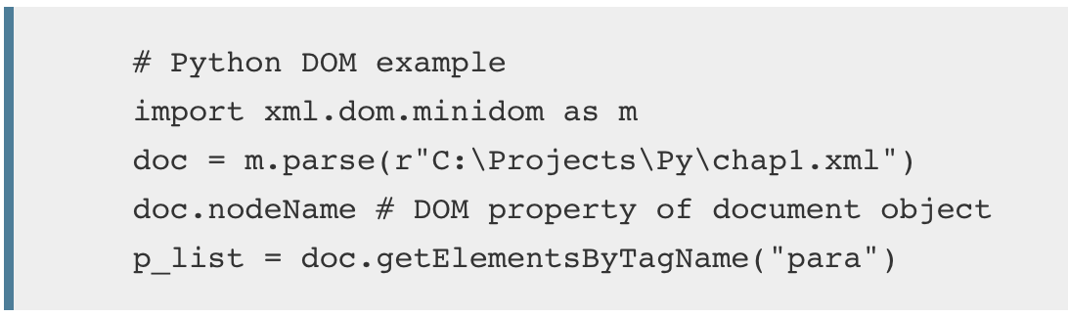
DOM and Programminng Language
The DOM was designed to be independent of any particular programming language, making the structural representation of the document available from a single, consistent API.
DOM can be built for any language, as this Python example demonstrates:

Slide 18
DOM and JavaScript - Overview
The DOM is not a programming language, but without it, the JavaScript language wouldn't have any model or notion of web pages
Every element in a document is part of the document object model for that document, so they can all be accessed and manipulated using the DOM and a scripting language like JavaScript.
The DOM was designed to be independent of any particular programming language, making the structural representation of the document available from a single, consistent API

Slide 19
Accessing the DOM
Section 3

Slide 20
Accessing the DOM
You don't have to do anything special to begin using the DOM.
Different browsers have different implementations of the DOM, and these implementations exhibit varying degrees of conformance to the actual DOM standard
But every web browser uses some document object model to make web pages accessible via JavaScript.

Slide 21
Accessing the DOM
When you create a script, you can immediately begin using the API for the document or window elements to manipulate the document itself or to get at the children of that document
Your DOM programming may be something as simple as the following, which displays an alert message by using the alert() function from the window object, or it may use more sophisticated DOM methods to actually create new content, as in the longer example below.

Slide 22
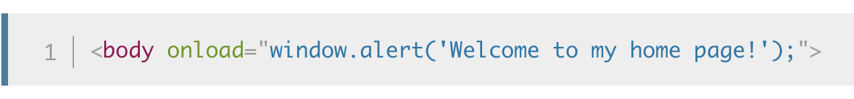
Accessing the DOM
This following JavaScript will display an alert when the document is loaded (and when the whole DOM is available for use):

Slide 23
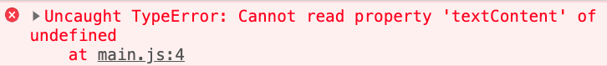
Accessing the DOM in <script>
Beware when access DOM in script, you may have the following error:
Notes:
Check: Unit 10 - Demo 2

Slide 24
Accessing the DOM in <script>
Because in HTML we load the <script> tag before HTML body
Notes:
Check: Unit 10 - Demo 2

Slide 25
Accessing the DOM in <script>
To fix this problem:
Make sure the script tag is before closing </body> tag
Or use defer attribute on <script> tag
Or wrap the code inside window.onload = function () {}
Notes:
Check: Unit 10 - Demo 2

Slide 26
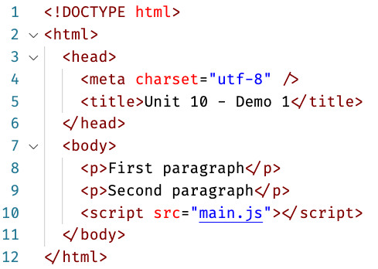
Accessing the DOM in <script>
Fix 1: by add <script> tag before closing </body> tag
Notes:
Work for simple problem, but no guaranteed that the document is parsed/presented when run main.js

Slide 27
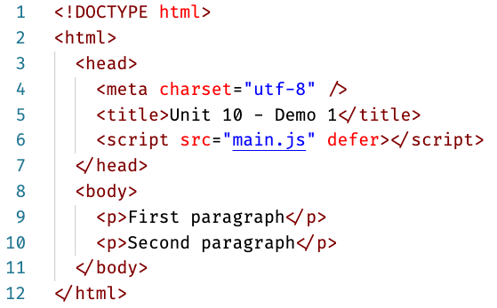
Accessing the DOM in <script>
Fix 2: by add defer attribute to <script> tag (Recommended)
Notes:
Guaranteed that the document is parsed/presented when run main.js

Slide 28
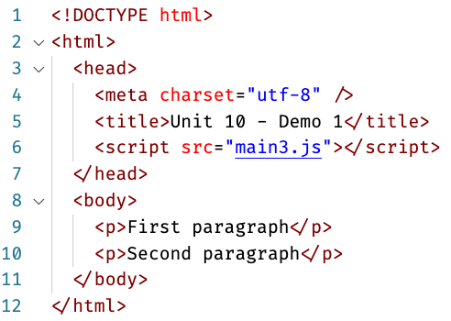
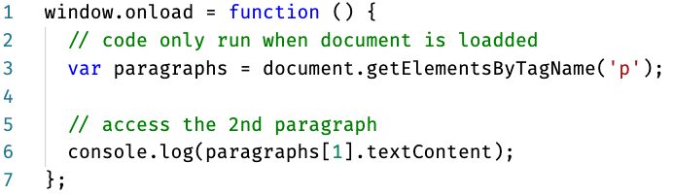
Accessing the DOM in <script>
Fix 3: wrap the code inside window.load = function () {}
main3.js
Notes:
Guaranteed that the document is loaded when run main3.js

Slide 29
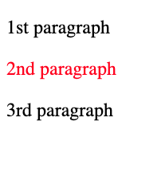
Demo 3
Add paragraph to document using DOM and JavaScript:

Slide 30
Accessing DOM – Practice 1
Notes:
Check: Unit 10 - Practice 1
Create a <h1> with Hello from FA text with color red

Slide 31
Accessing window
window represents the currently opened window (or browser Tab)
Useful properties/method:
Location: window.location
Scroll: window.scrollTo
Browser: window.navigatior

Slide 32
Accessing window - Demo
Demo accessing window object
Log out current URL
Navigate to another URL
Scroll using JS
Scroll using JS but smoth scroll
Notes:
Check: Unit 10 - Demo 4

Slide 33
Accessing the DOM - Overview
You don’t have to declare anything, the DOM is provided to you by the Browser
Inside <script> tag or JavaScript file, you have access to document or window object
document represents the HTML document. Use this when you want to manipulate the HTML page
window represents the currently opened window (or browser Tab). Use this when you want to control the Browser behavior such as go to another url

Slide 34
Fundamental data types
Section 4

Slide 35
Fundamental data types
This reference tries to describe the various objects and types in simple terms.
But there are a number of different data types being passed around the API that you should be aware of.
Note: tt's common to refer to the nodes in the DOM as Elements, although strictly speaking not every node is an element.

Slide 36
Fundamental data types
Data type (Interface) | Description
Document | When a member returns an object of type document (e.g., the ownerDocument property of an element returns the document to which it belongs), this object is the root document object itself. The DOM document Reference chapter describes the document object.
Node | Every object located within a document is a node of some kind. In an HTML document, an object can be an element node but also a text node or attribute node.
Element | The element type is based on node. It refers to an element or a node of type element returned by a member of the DOM API. Rather than saying, for example, that the document.createElement() method returns an object reference to a node

Slide 37
Fundamental data types
Data type (Interface) | Description
NodeList | A nodeList is an array of elements, like the kind that is returned by the method document.getElementsByTagName(). Items in a nodeList are accessed by index in either of two ways: list.item(1) list[1] These two are equivalent. In the first, item() is the single method on the nodeList object. The latter uses the typical array syntax to fetch the second item in the list.
Notes:
There are also some common terminology considerations to keep in mind. It's common to refer to any Attribute node as simply an attribute, for example, and to refer to an array of DOM nodes as a nodeList. You'll find these terms and others to be introduced and used throughout the documentation.

Slide 38
Fundamental data types - Summary
Documen, Node and Element are three most important Data Type
There are also some common terminology considerations to keep in mind.
It's common to refer to any Attribute node as simply an attribute, for example, and to refer to an array of DOM nodes as a nodeList.
You'll find these terms and others to be introduced and used throughout the documentation

Slide 39
Locating DOM elements using selectors
Section 5

Slide 40
Locating DOM elements using selectors
The Selectors API provides methods that make it quick and easy to retrieve Element nodes from the DOM by matching against a set of selectors.
This is much faster than past techniques, wherein it was necessary to, for example, use a loop in JavaScript code to locate the specific items you needed to find.

Slide 41
Locating DOM elements using selectors
querySelector(): Returns the first matching Element node within the node's subtree. If no matching node is found, null is returned.
querySelectorAll(): Returns a NodeList containing all matching Element nodes within the node's subtree, or an empty NodeList if no matches are found.
Note: The NodeList returned by querySelectorAll() is not live, which means that changes in the DOM are not reflected in the collection. This is different from other DOM querying methods that return live node lists.
Notes:
You may find examples and details by reading the documentation for the Element.querySelector() and Element.querySelectorAll() methods, as well as in the article Code snippets for querySelector.

Slide 42
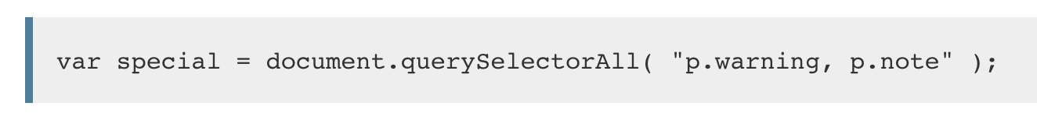
Locating DOM elements using selectors
The selector methods accept one or more comma-separated selectors to determine what element or elements should be returned.
For example, to select all paragraph (p) elements in a document whose CSS class is either warning or note, you can do the following:

Slide 43
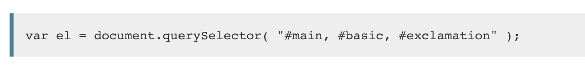
Locating DOM elements using selectors
You can also query by ID. For example:
After executing the above code, el contains the first element in the document whose ID is one of main, basic, or exclamation.
You may use any CSS selectors with the querySelector() and querySelectorAll() methods.
Notes:
After executing the above code, el contains the first element in the document whose ID is one of main, basic, or exclamation.
You may use any CSS selectors with the querySelector() and querySelectorAll() methods.

Slide 44
Locating DOM elements using selectors
Once you have selected an Element, you can do the following to it:
Change its content with (textContent or innerHTML)
Change its style with (el.style)
Change its class with (el.classList.add or el.classList.remove)
Add Event listener (Unit 11)
Check Demo 5
Notes:
Check Demo 5

Slide 45
Selectors API – Practice time
Practice Selectors API
Use querySelector() and universal selector to selects the first element in the document.body
Selects all h2 elements and add background-color: #ccc to them
Selects first element with class .menu-item and add class .active to it
Selects the item with id #logo and change its src to another image URL (use Google image to get another image)
Finds all li elements that are directly inside a <ul> element and change the 1st li text to ‘Test’

Slide 46
Selectors API - Overview
Use any CSS selectors with the querySelector() and querySelectorAll() methods to locating the desired Element
Once you selected an Element, you can modify its text content, change its appearance or even append new Element

Slide 47

Thank you
Q&A

